Slide 1


CONGRATULATIONS
City Temple Of Baltimore Baptist
2020 Graduates
Pomp and Circumstance Graduation Walking March (Song Extended)

Slide 2

GRADUATING FROM ELEMENTARY SCHOOL

Slide 3
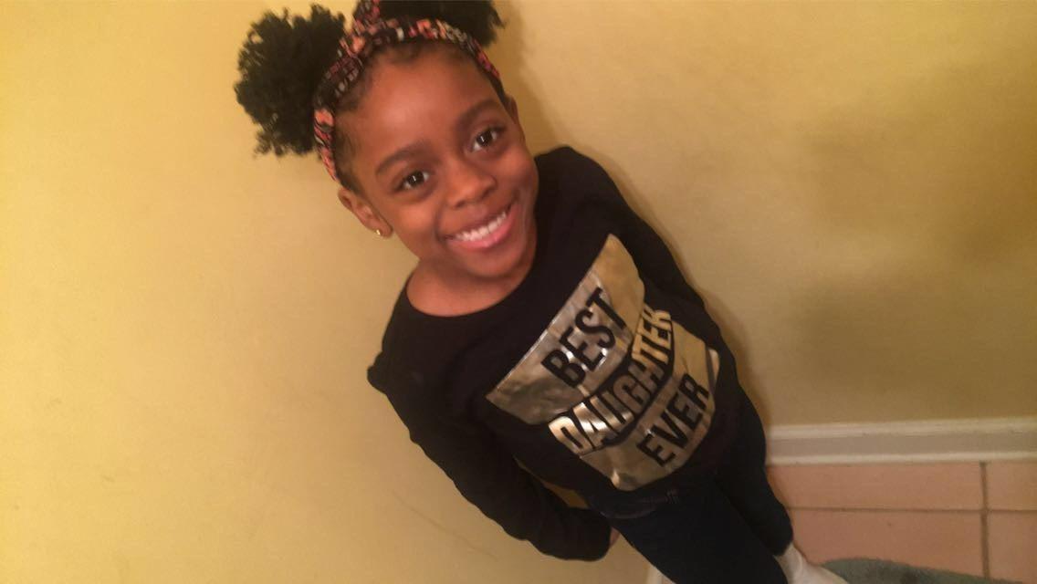
IVY WILKS

Slide 4

Superlatives
Girl with the cutest smile
Ivy is an amazing young lady who will light up the room as soon as she enters. Ivy is a very determined young lady. When she is done, she is done! Thank Goodness she was done with Kindergarten!

Slide 5
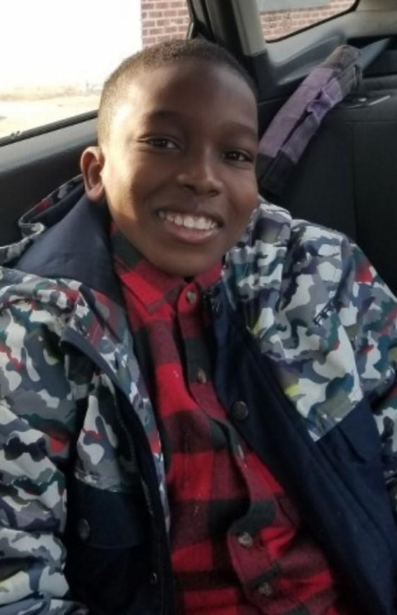
Corey Ameen
Known for his high energy and inquisitive mind, Corey’s teachers have praised him for science and art projects. Corey is in several clubs. He plays baseball, football and basketball.
At City Temple he is known for asking thoughtful questions, his willingness to help and most importantly his beautiful smile.

Slide 6
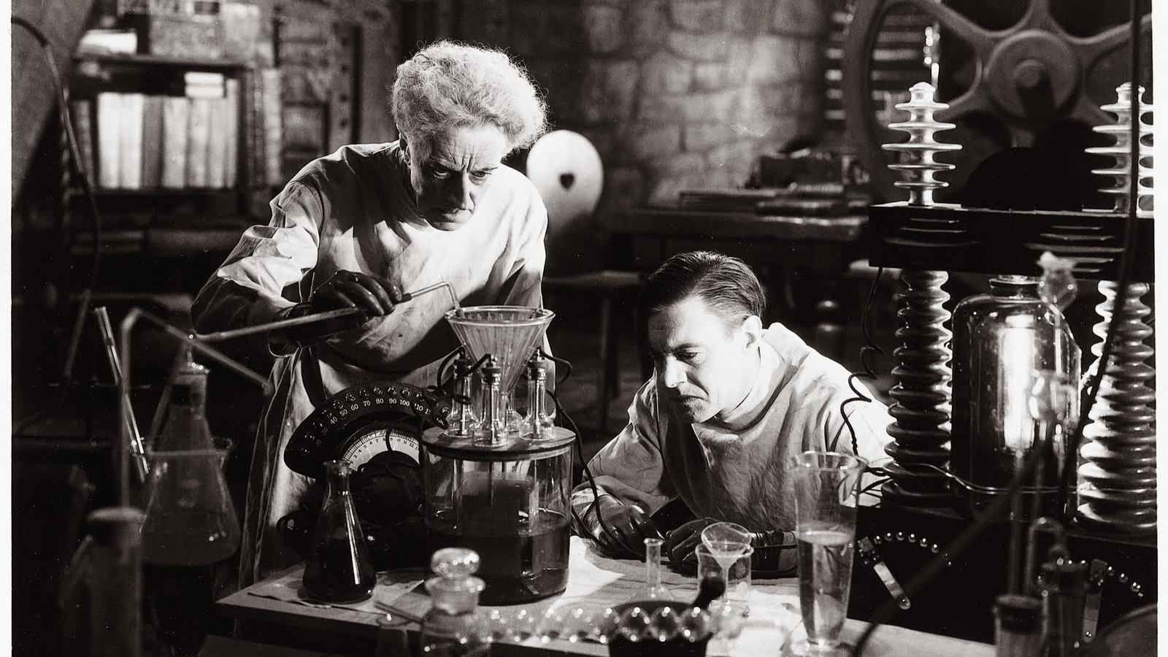
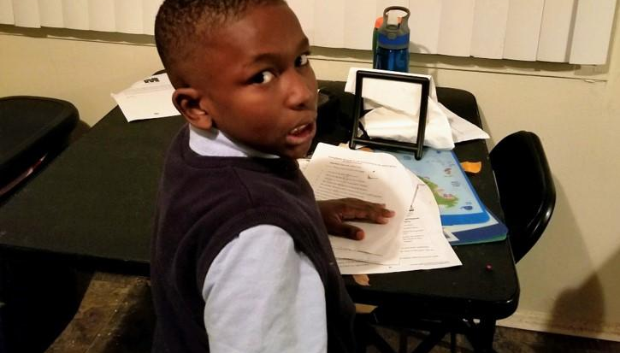
Superlative
Most likely to become a Mad Scientist
This Photo by Unknown Author is licensed under CC BY-NC-ND

Slide 7
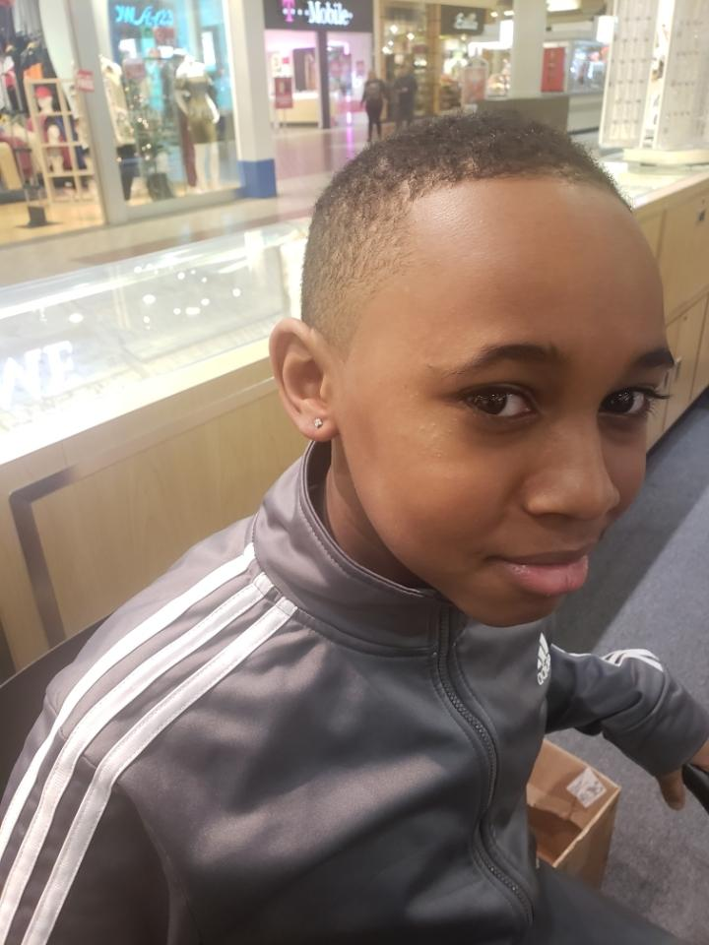
Rhys Brown is an eleven year old fifth grade student who attends Roland Park Elementary Middle School. Rhys is an excellent student. He has maintained an A average from Kindergarten until now. His charming personality is the reason he is loved by many. Rhys' favorite subject is Art. He also loves to bake and read in his spare time. He plays little league baseball for James Mosher Baseball League. This fall Rhys will be attending Friends School of Baltimore. He will do great things.

Slide 8
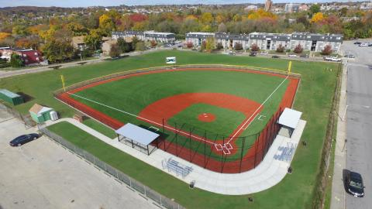
Superlative
Most Likely to Enter the Baseball Hall of Fame as the Smartest Player to ever Play the Game!
He will join Baltimore Greats
Leon Day-Baltimore Elite Giants
Eddie Murray
Cal Ripkin
Frank Robinson

Slide 9
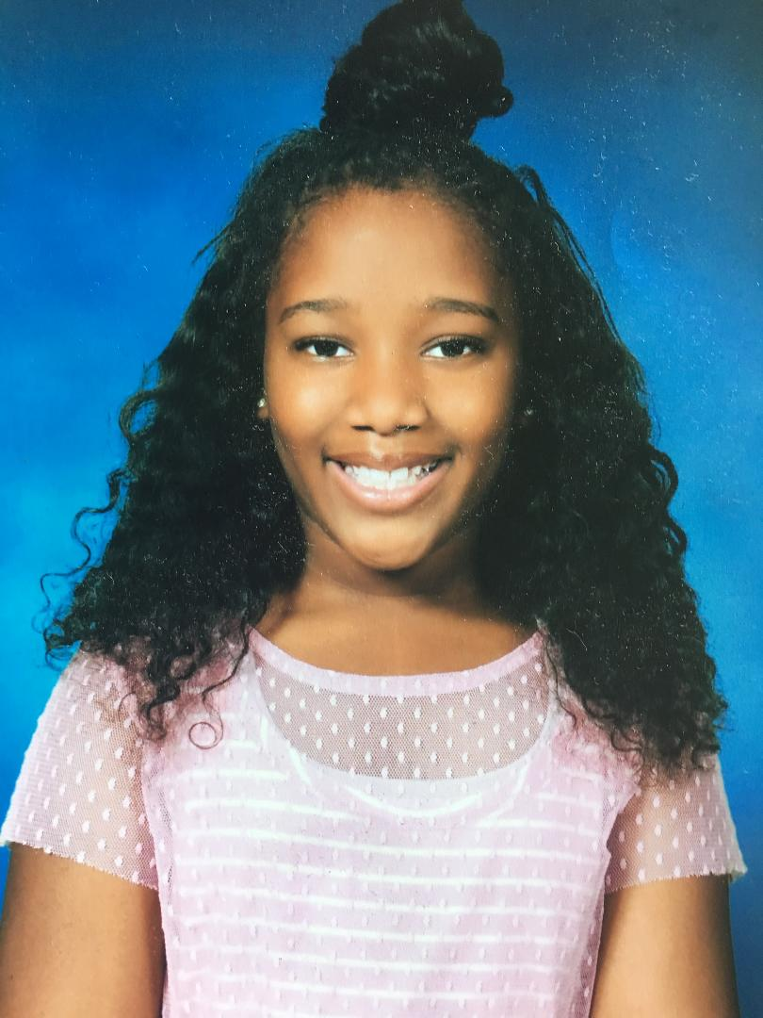
Alannah Marlene Parker
An Honor Roll Student at Cardinal Shehan Catholic School
is progressing to the 6th grade.
Alannnah is always actively engaged in Sunday School and Children’s Church
Alannah can find a scripture easily without assistance.
Superlative
Most likely to be a Theologian

Slide 10
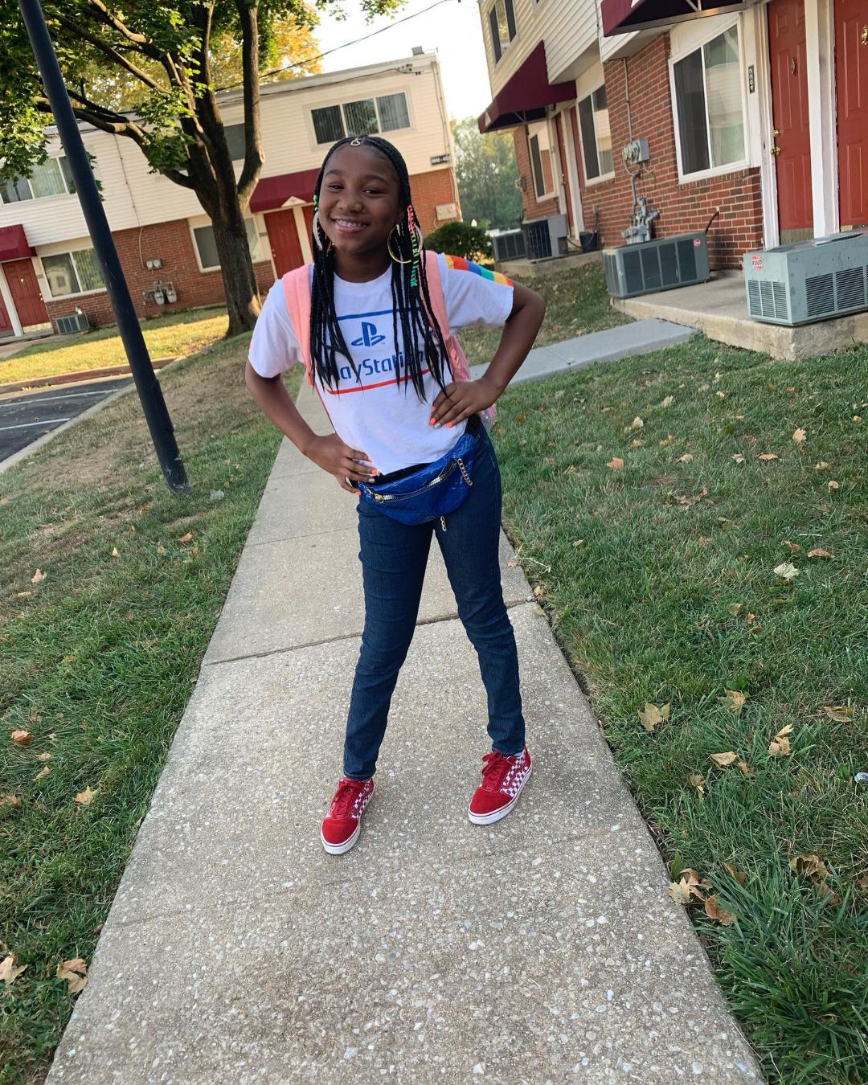
Taliyah Boston
Sweet and Sassy and always willing to have fun.
Middle School won’t be the same when she arrives.
Superlative
Most likely to
Tell it Like it Is!

Slide 11

Graduating from
MIDDLE SCHOOL

Slide 12
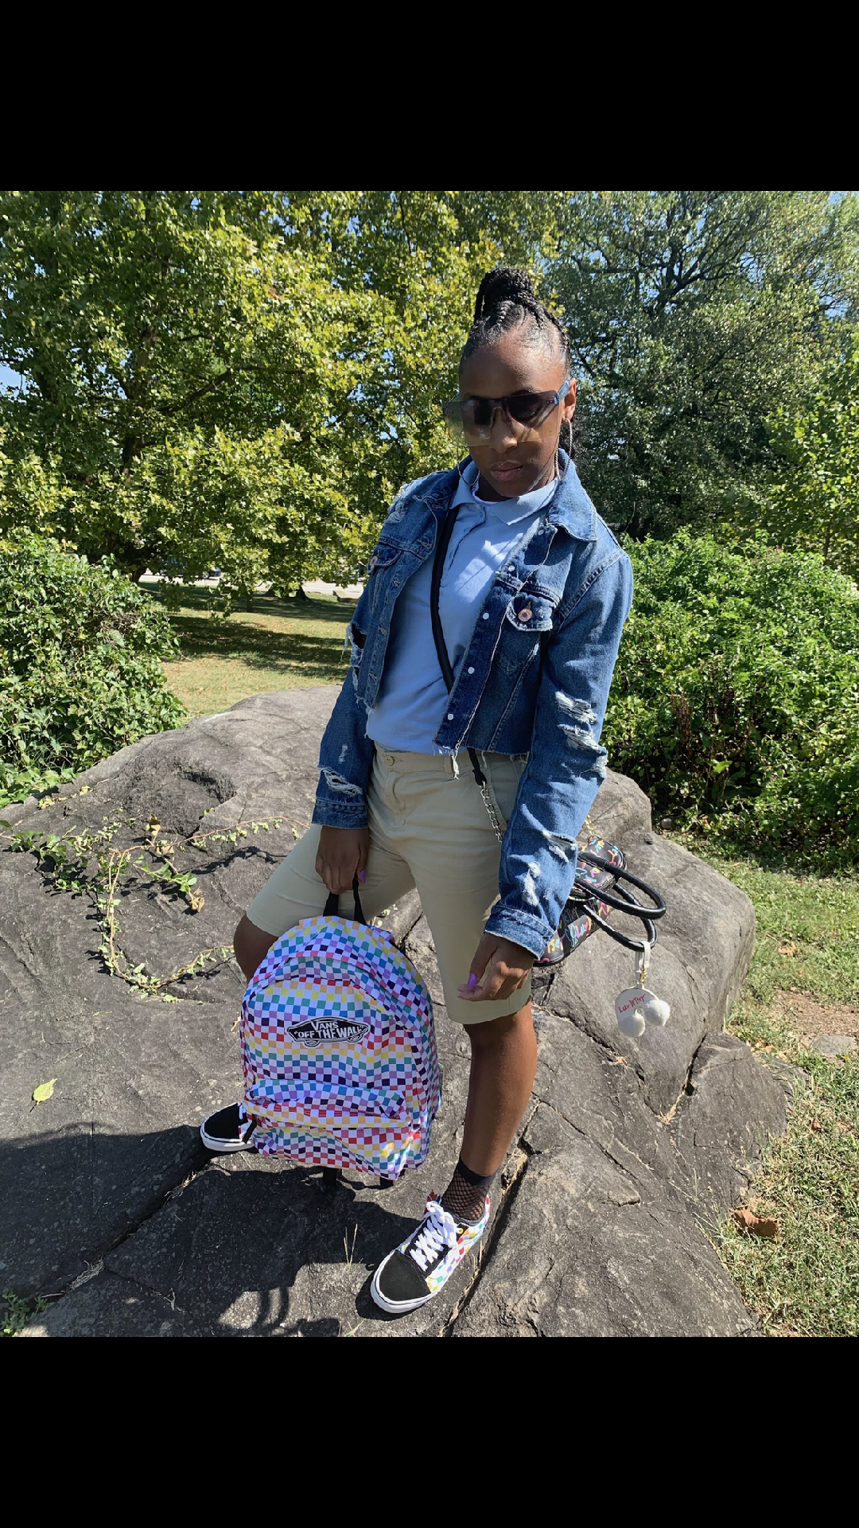
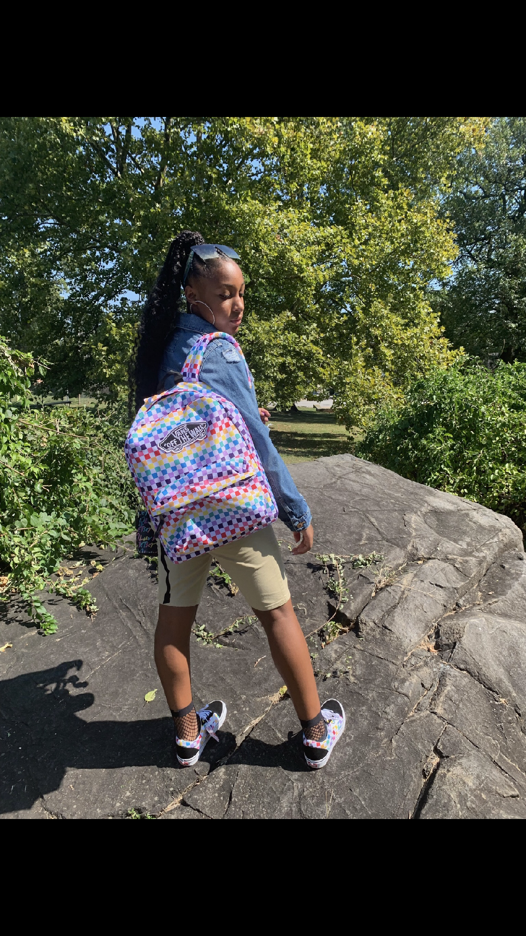
De’Arie Walker
Headed to High School, De’Arie had perfect attendance. Acknowledged for Modeling, Acting and Dance. She is always the fashion statement when she arrives at church!
Superlative
Most Likely to Be
A High Fashion Model

Slide 13
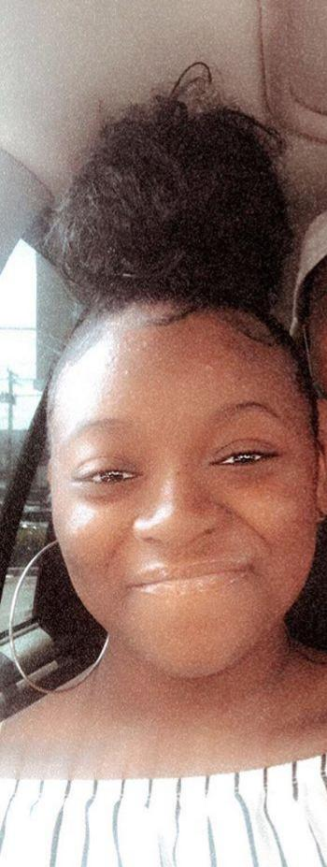
Isis Wilks
This amazing young lady is a member of God’s Gifts I and II. She is a quiet spirit. She is an usher and an amazing worship leader. Her eighth grade year was cut short but that’s alright because she is headed to
New Towne High School!!!
Superlative
Mostly Likely to Be in Charge!The Boss

Slide 14
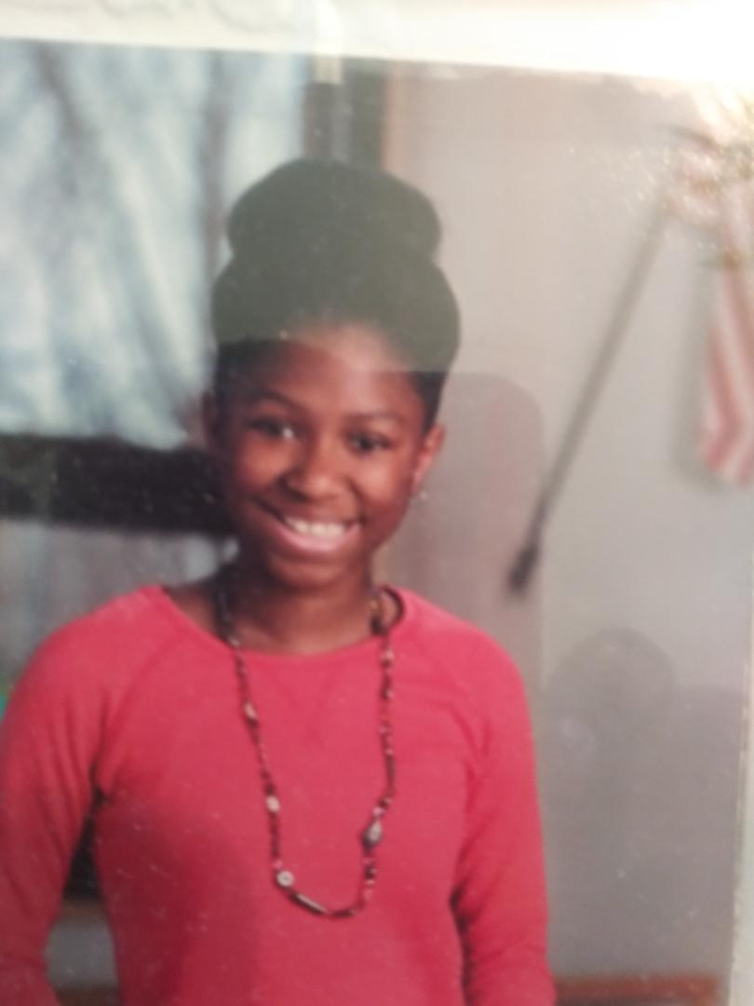
Janai Fields
Known to be a quiet deep thinker. She can be found alone with a good book. Ask her a question, you will find she is wise beyond her years. She will be attending Western High School- Only the best High School in the State.
You GO my fellow Dove!
Superlative
Most likely to become a CEO of a major Library System

Slide 15
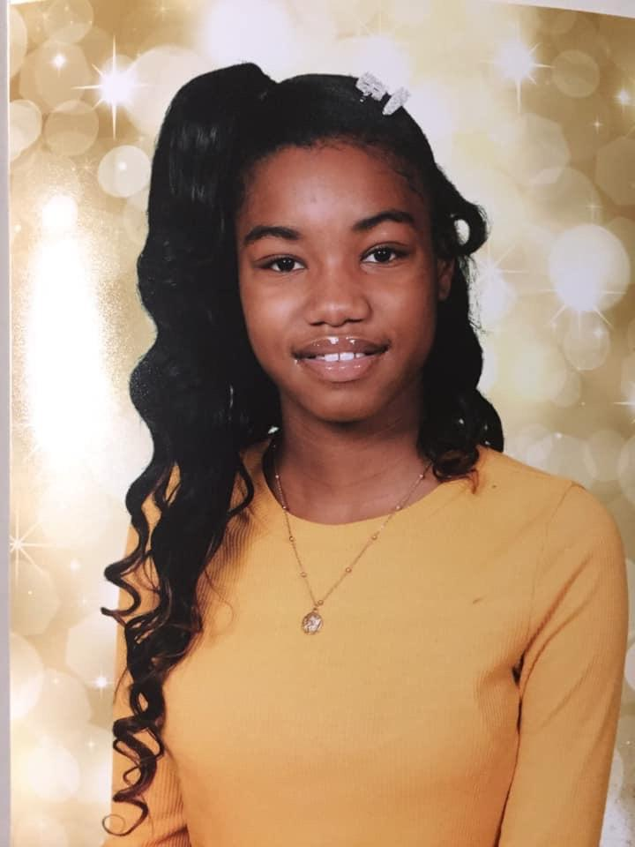
Sanaa Lovelist
Active in the Children’s Church. Sanaa is a ray of sunshine. She is a quiet spirit.
Superlative
Most Likely to always be kind.

Slide 16

Graduating from
High School

Slide 17
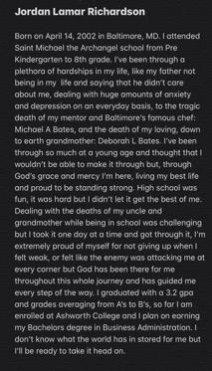
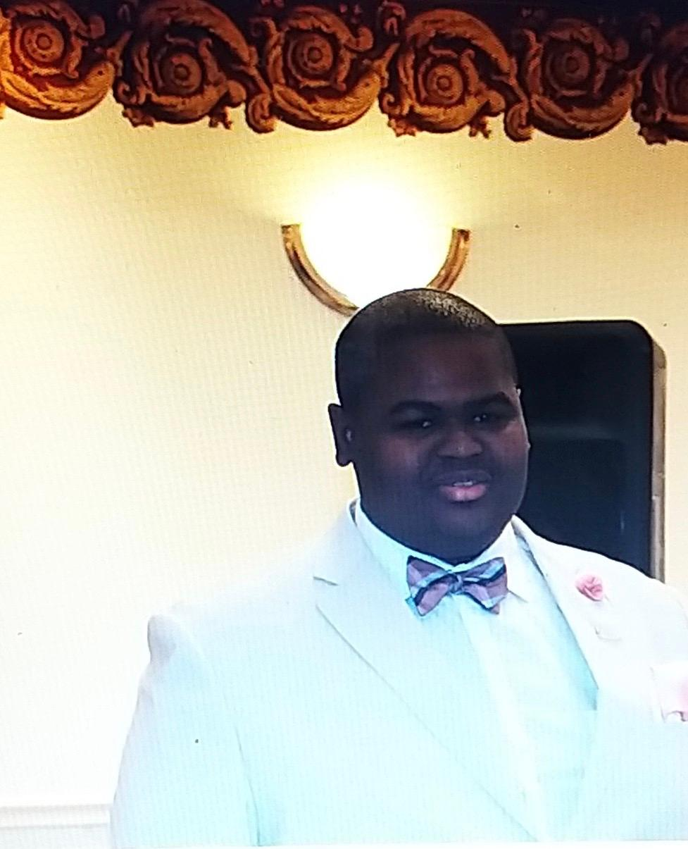

Slide 18
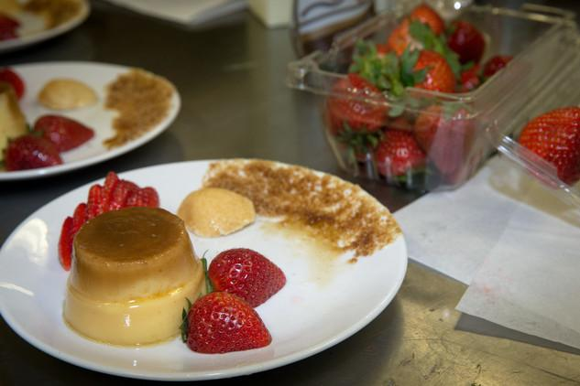
Superlative
Most Likely To Win “USA’s Chef of the Year” and have his own cooking show

Slide 19
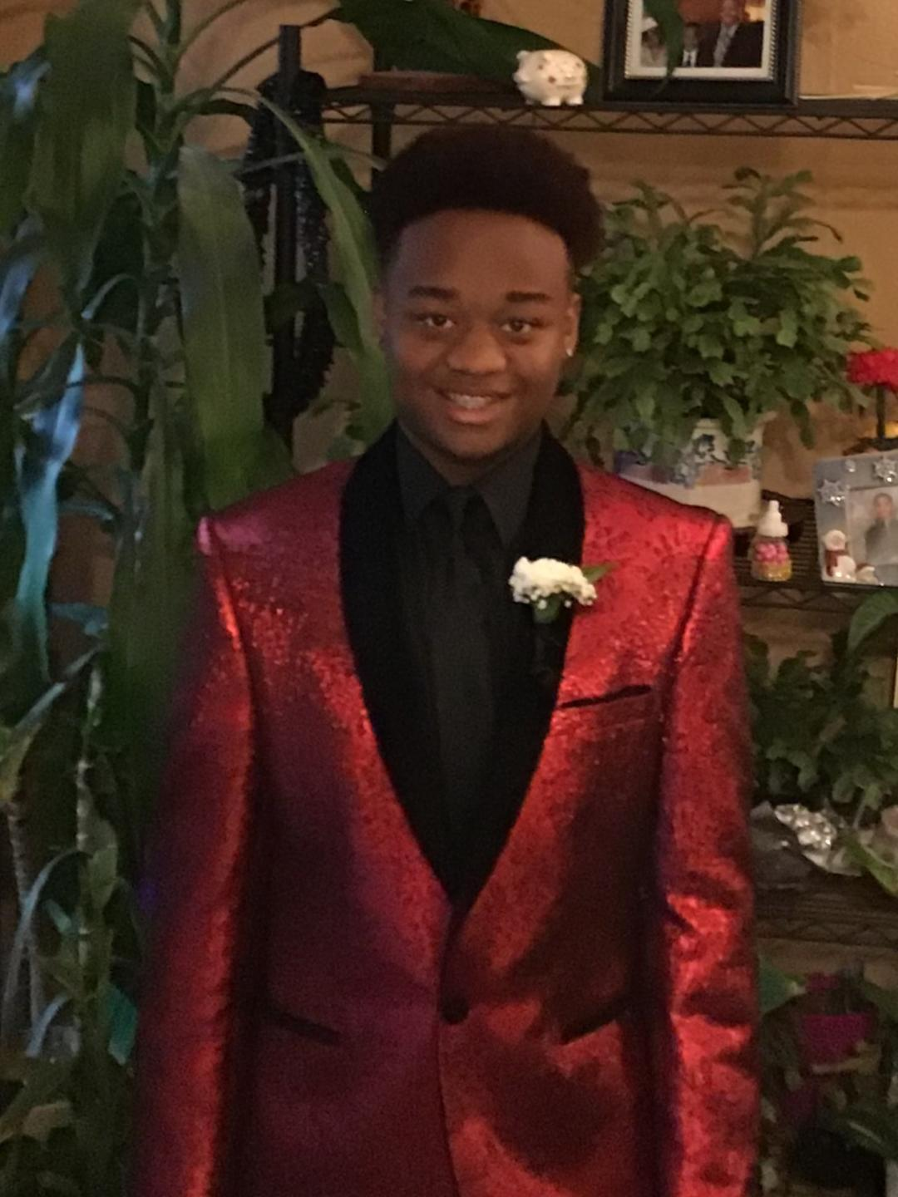
Joshua Lindsay
During my entire high school life, I’ve always been proud of my independence and perfect attendance. Before I had my house fire I have always been on time to school, never missed a day in school and always been on time to my classes for about five years. Something else that I would like to add is my extra curricular program called Bridges. This program has had a large impact on my life because this program would provide me with guidance towards students the way the students would want it. They have helped me select colleges, scholarships, and helped me choose what my future career could be. Throughout this journey of going to my program they have also provided me jobs. One year when I was going into the 9th grade I worked with special needs children at the Baer school, and the next two years I worked with a company named “Art with a Heart”. Finally almost all my life I have been an usher for City Temple. But as I grew up I wanted to try something different for the church and work with the tape ministry. But overall I’m just proud of myself for achieving all that I have achieved. I have been accepted in to Bowie State, Central State in Ohio, Lincoln University, Washington State and many more but I have finally decided that I want to attend Bowie this fall!

Slide 20
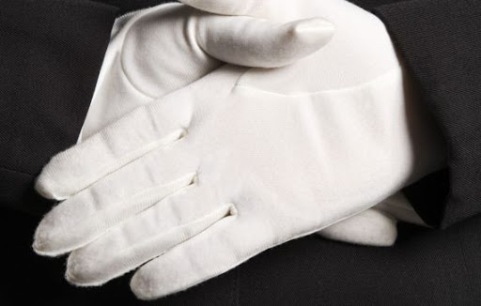
Superlative
Most Likely to Be a Head Usher!

Slide 21

Graduating from College

Slide 22
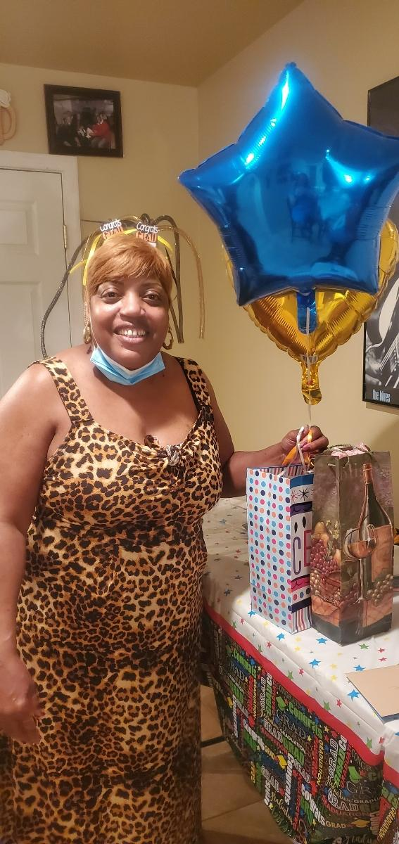
Charlotte Richards
In 2017, Charlotte graduated with a degree in Human Services and realized at that time she had discovered her purpose. In October of 2017, Charlotte resigned from her job of 23 years to pursue a career in addiction counseling. Once Charlotte started the job, she realized that she had found her passion and purpose and decided to continue with the higher education needed in order to obtain more knowledge needed to provide the services needed at a higher level to her client. Charlotte started Coppin State University in 2017 to pursue a bachelor’s degree toward Alcohol and Drug Counseling. Charlotte knew that she finally found her calling and knew this was what she needed to do. Charlotte decided to close the Assisted Living Facility she had operated for 18 years after God told her it was ok and time to move on. Charlotte is happy to announce that she graduated May 2020 with a degree in Psychology with concentration in Alcohol and Drug Abuse Services. Charlotte is now working towards deciding about what is next but decided to wait on a message from God.

Slide 23
Superlative
Most likely to Analyze you,
for a Fee!

Slide 24
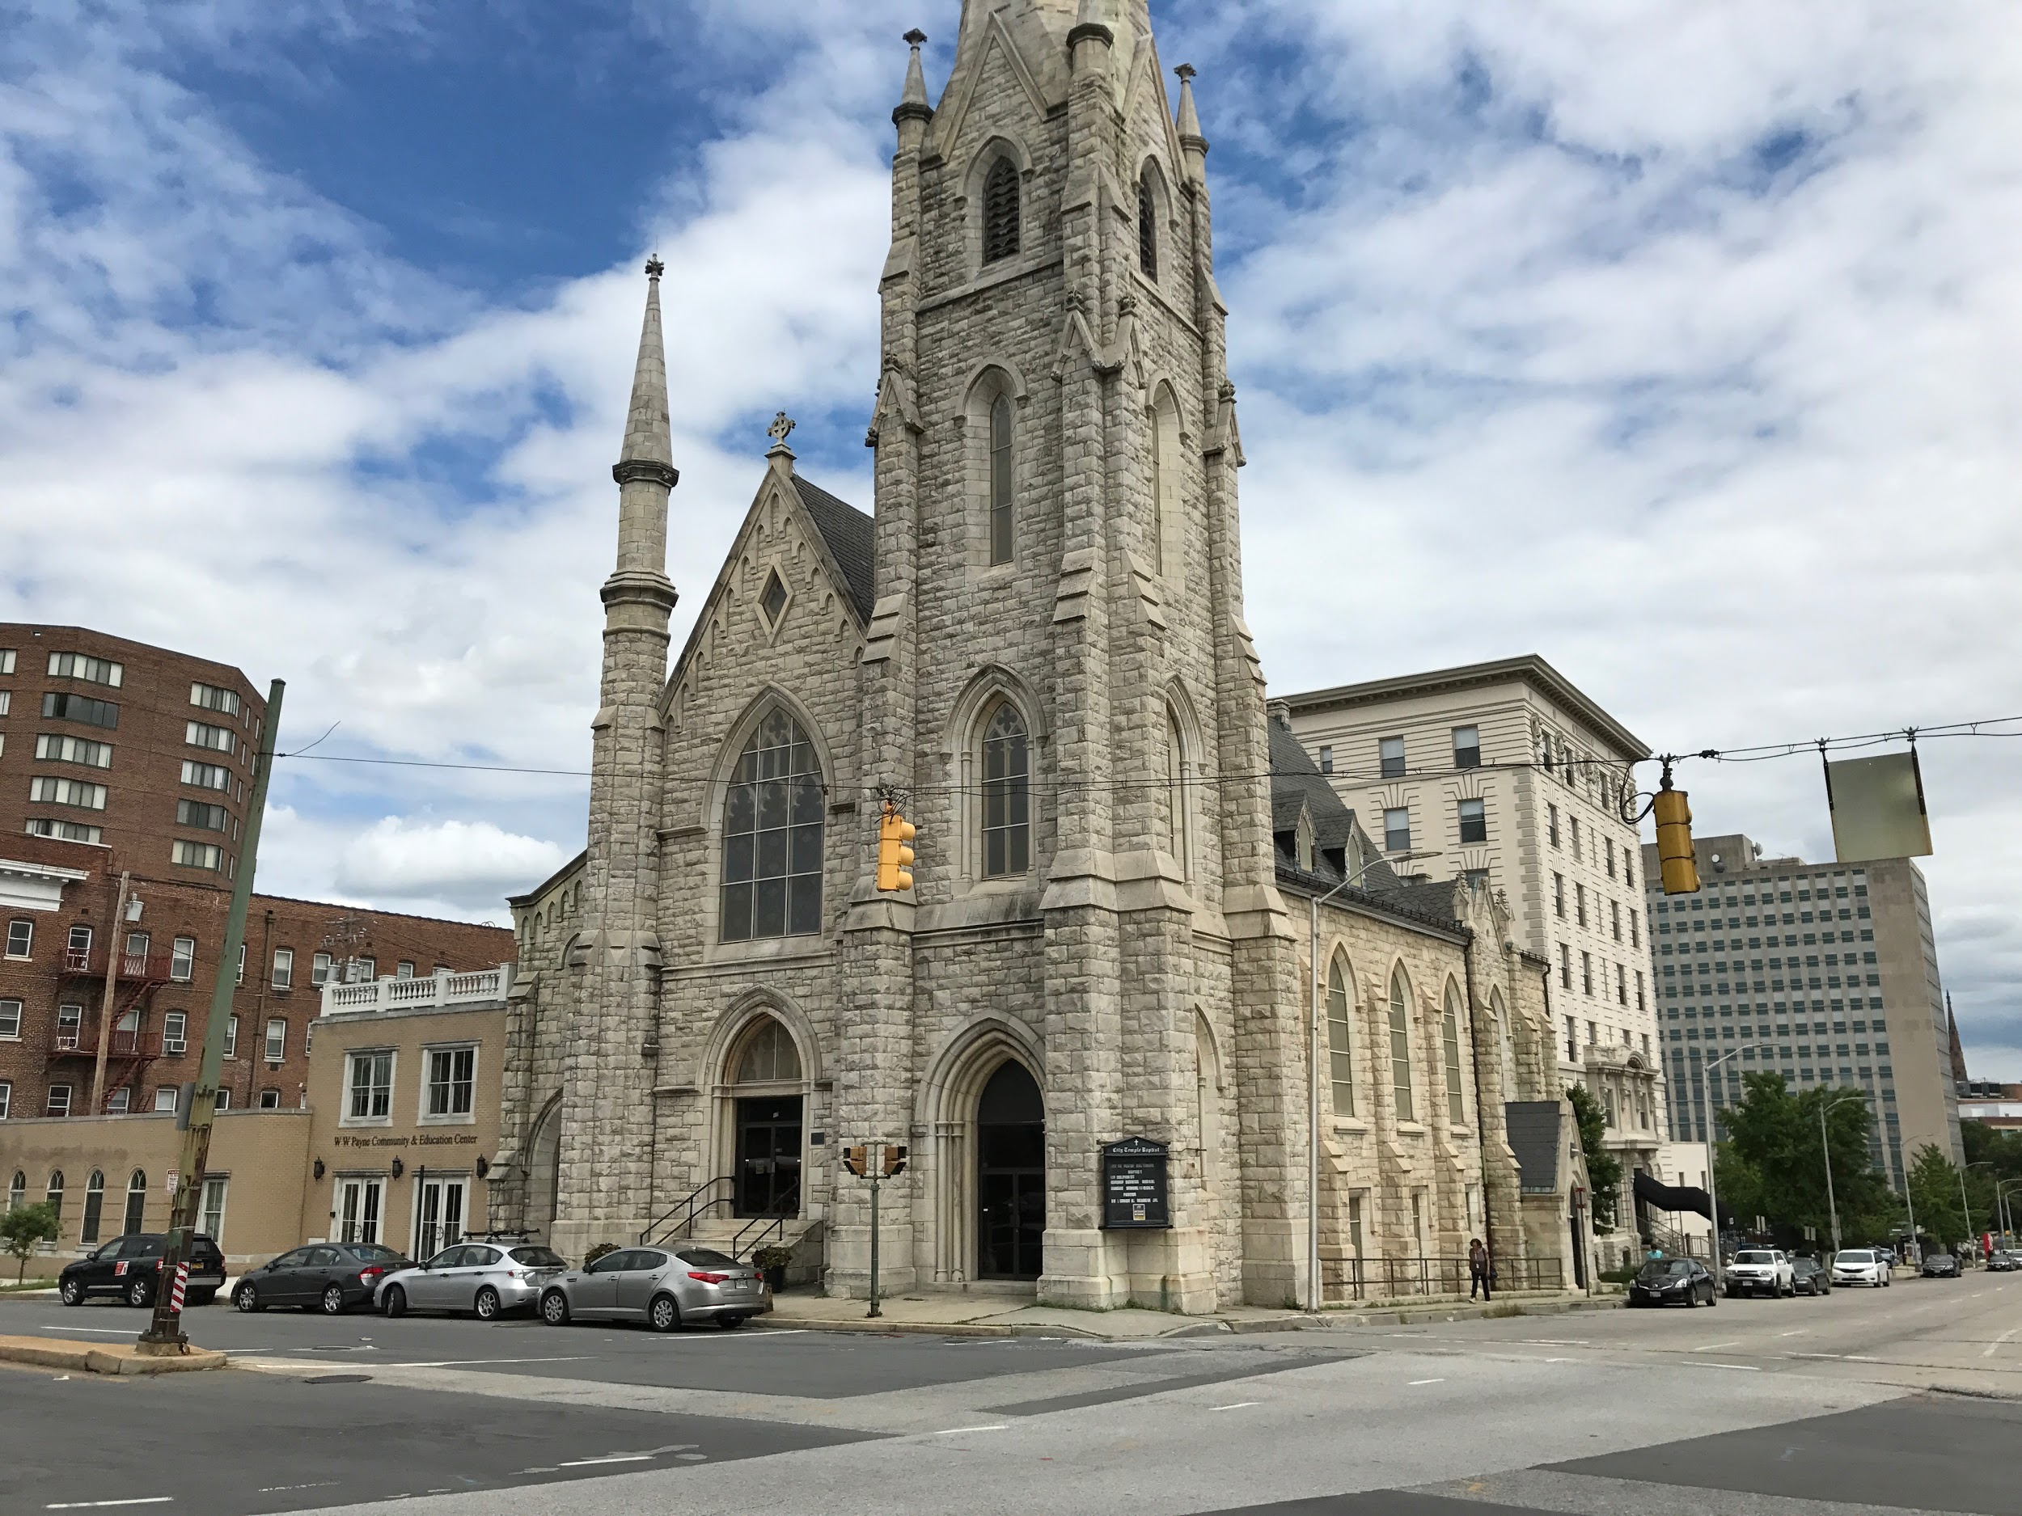
Please Join Us in Celebrating
Our 2020
Graduates
Phillippians 4:13 - Common English Bible
“I can endure all these things through the power of the one who gives me strength.”
We are looking forward to you doing amazing things!!
Go Forth, Be Awesome, and Do Epic Stuff. Be a force to change this world for good.
We are so very Proud of You!
Rev. Grady A. Yeargin Pastor

